Slide 1
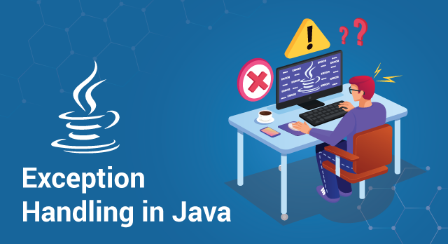

Slide 2
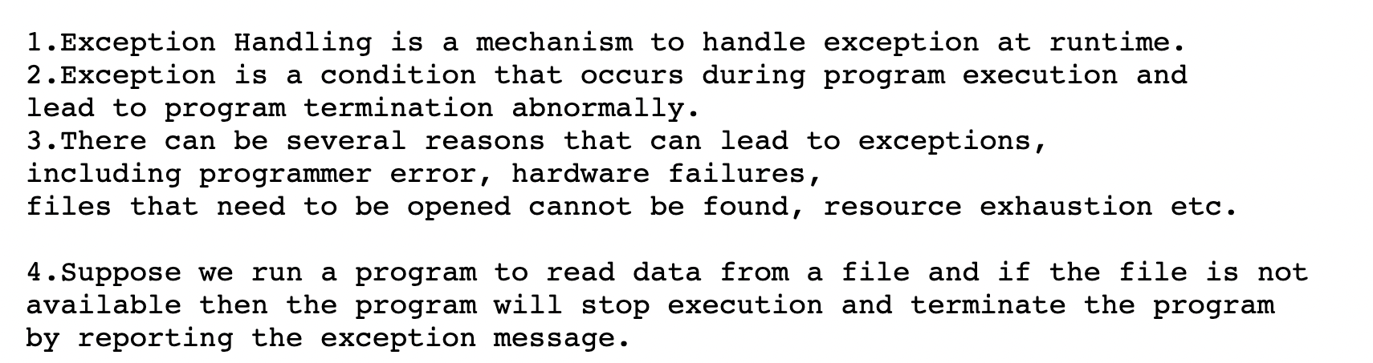
EXCEPTION HANDLING IN JAVA

Slide 3
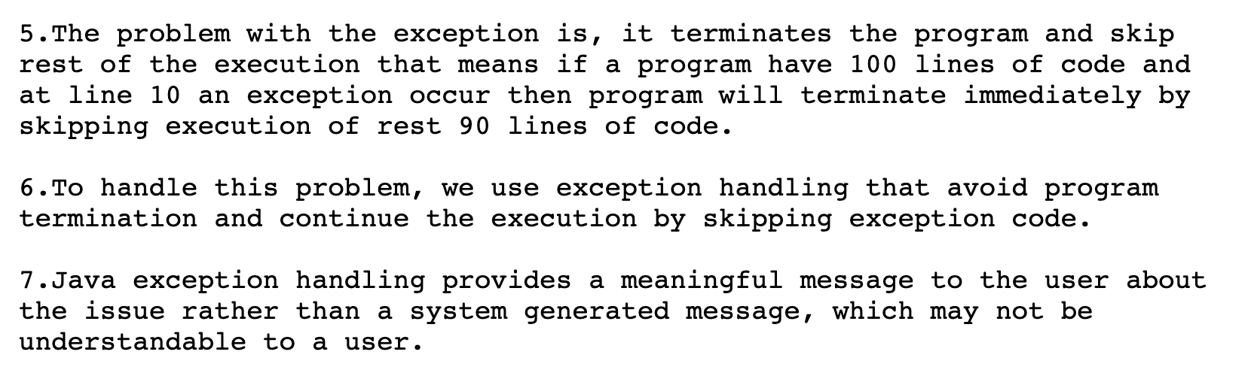
EXCEPTION HANDLING IN JAVA

Slide 4
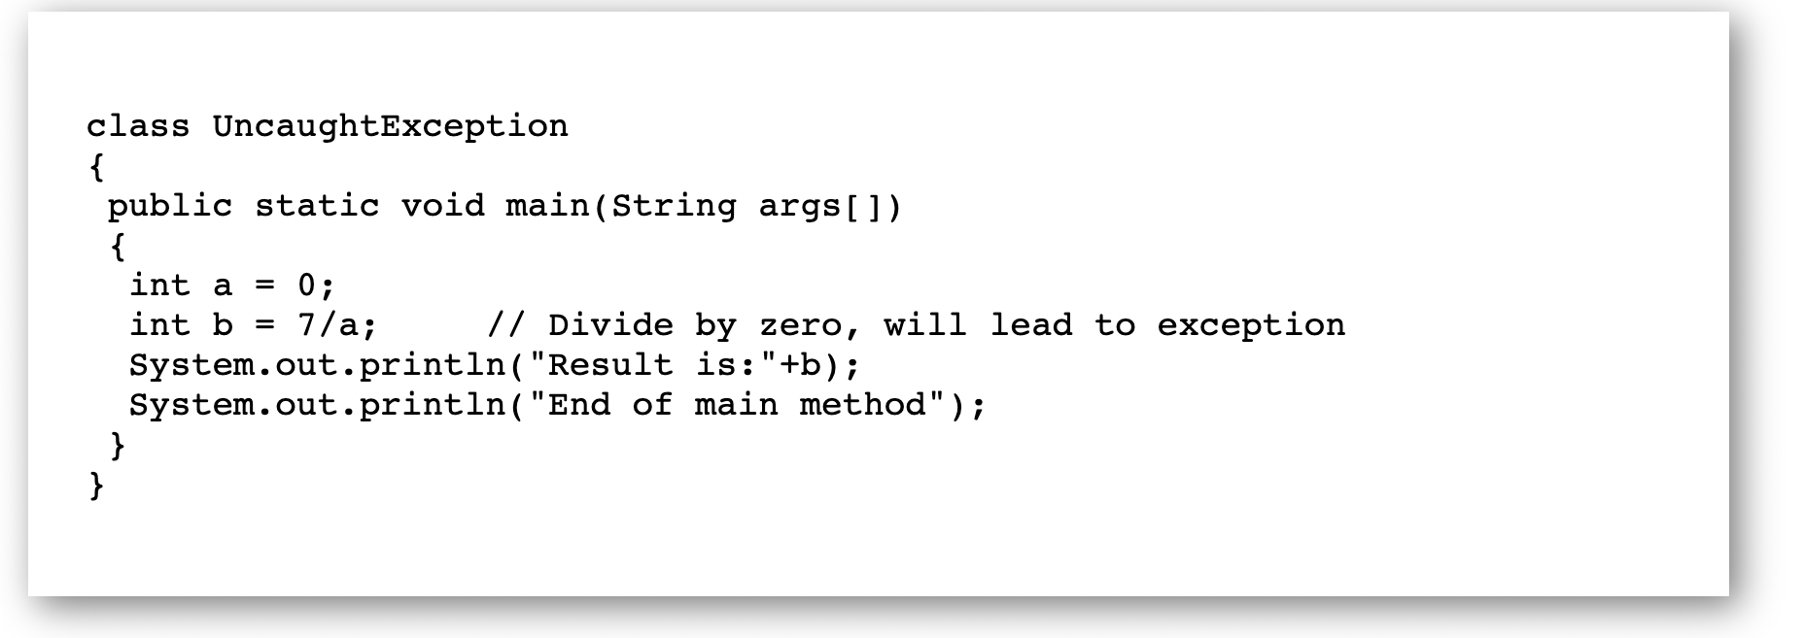
JAVA: Uncaught Exception

Slide 5
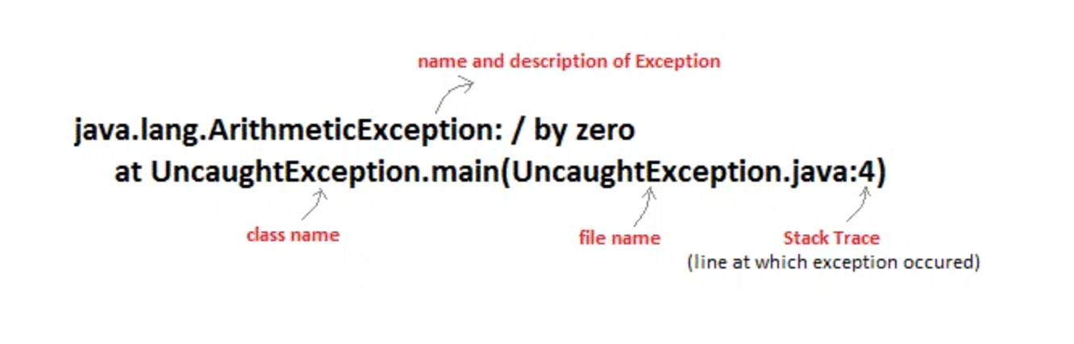
JAVA: Uncaught Exception

Slide 6
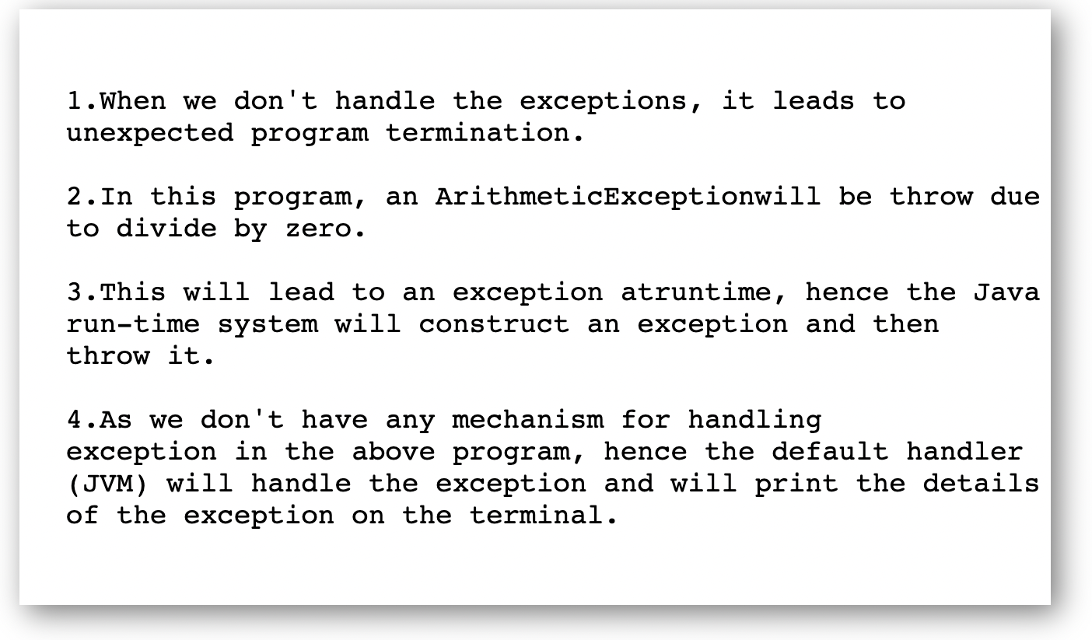
JAVA: Uncaught Exception

Slide 7
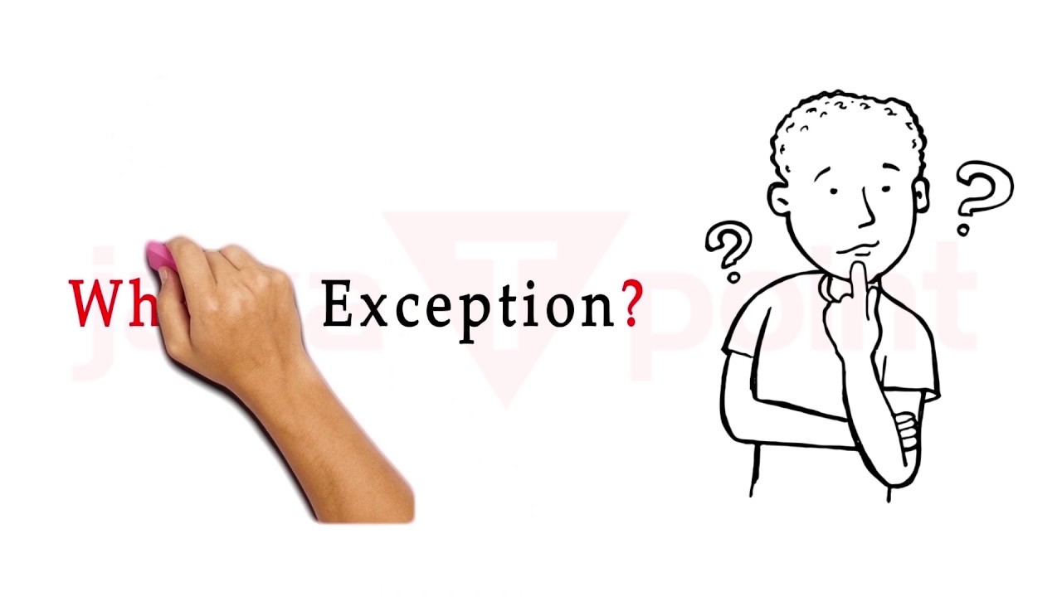
JAVA: What Is Exception?

Slide 8
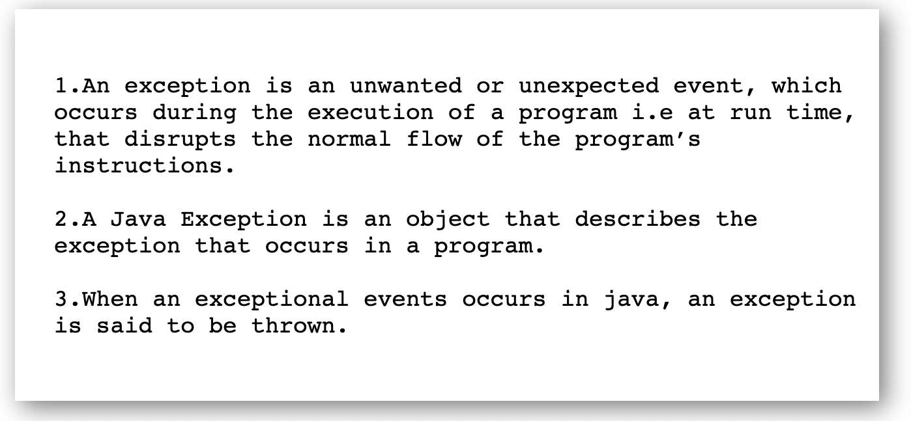
JAVA: What Is Exception?

Slide 9
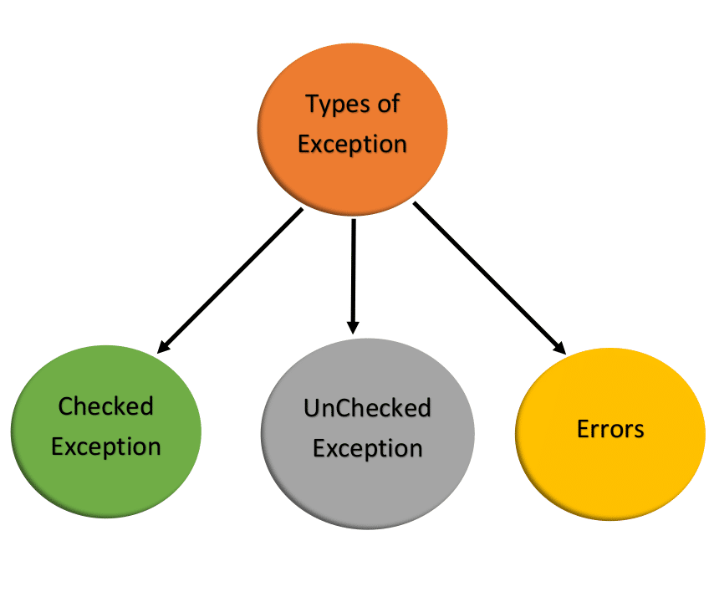
JAVA: Types Of Exception

Slide 10
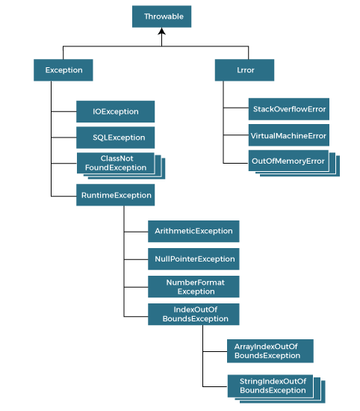
JAVA: Exception Hierarchy

Slide 11
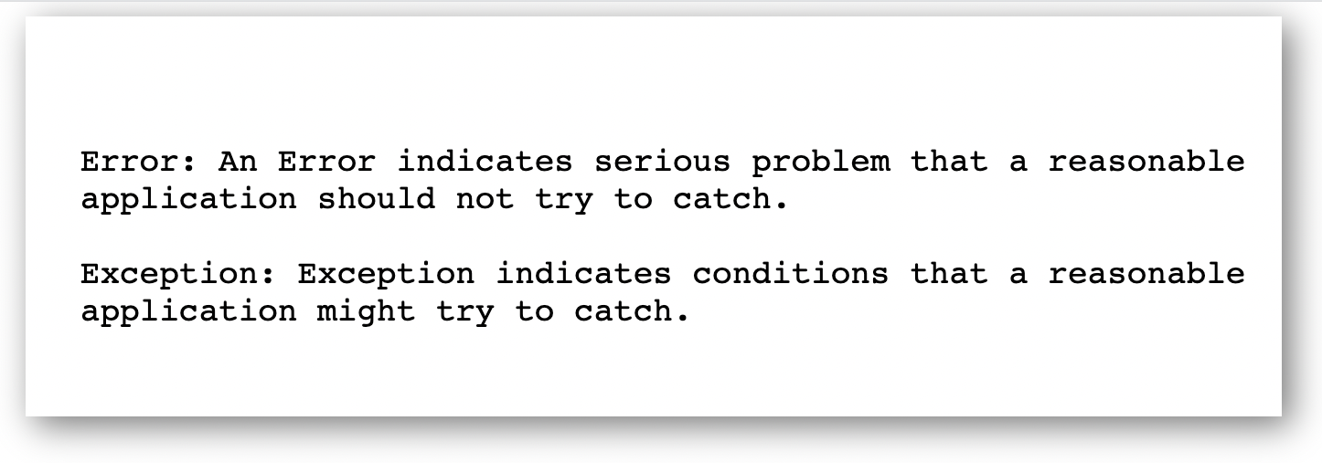
JAVA: Error vs Exception

Slide 12
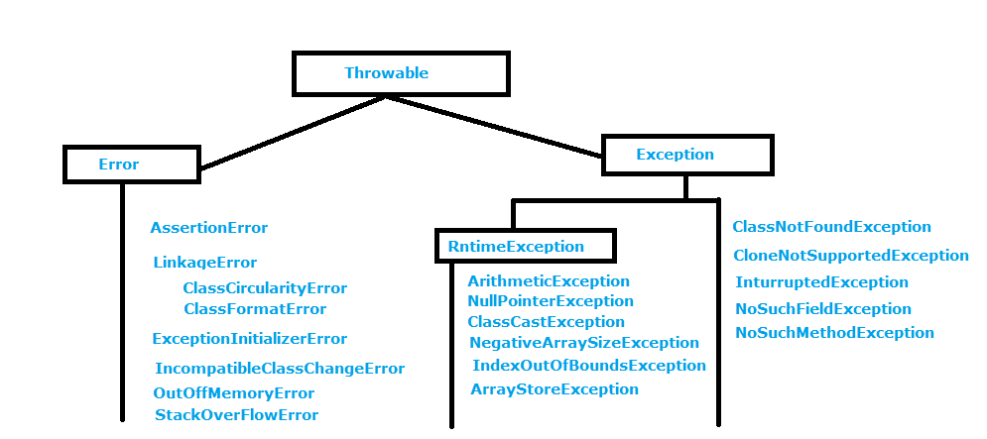
JAVA: Error vs Exception

Slide 13
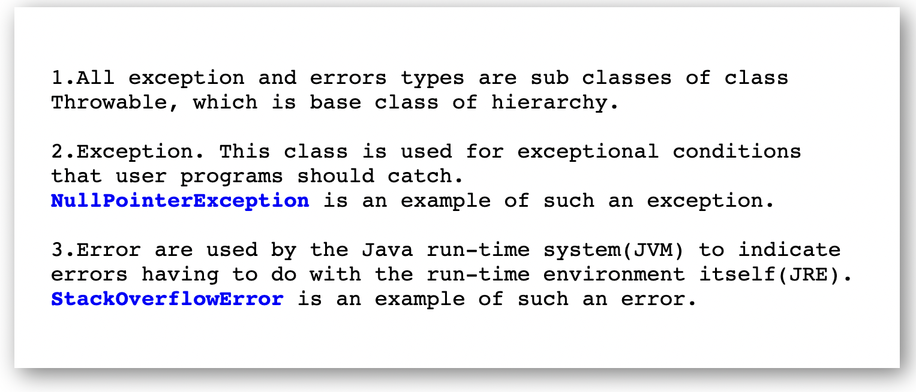
JAVA: Exception vs Error

Slide 14
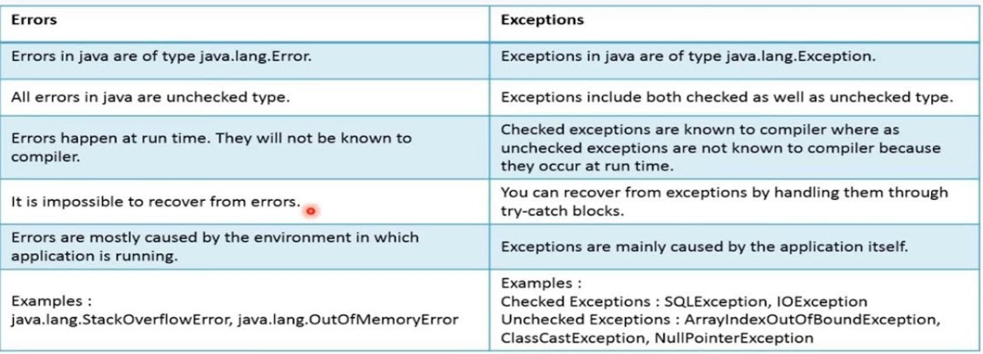
JAVA: Error vs Exception

Slide 15
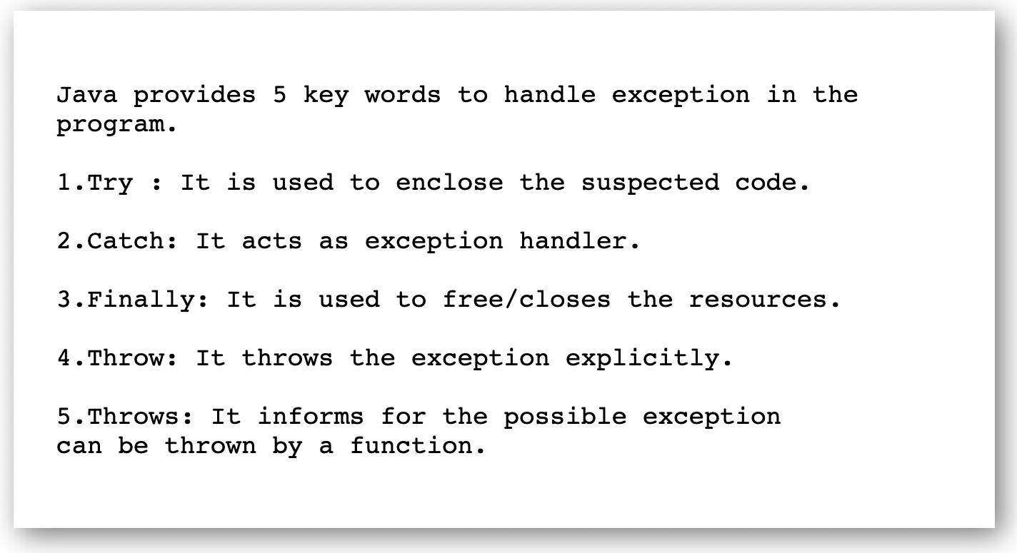
JAVA: Exception Handling.

Slide 16
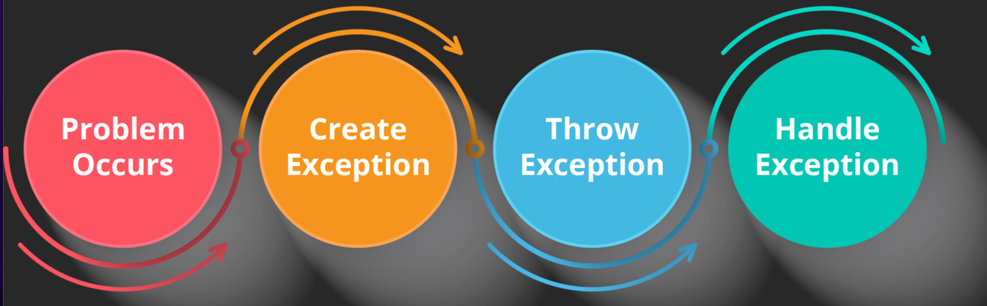
JAVA: Exception Handling.

Slide 17
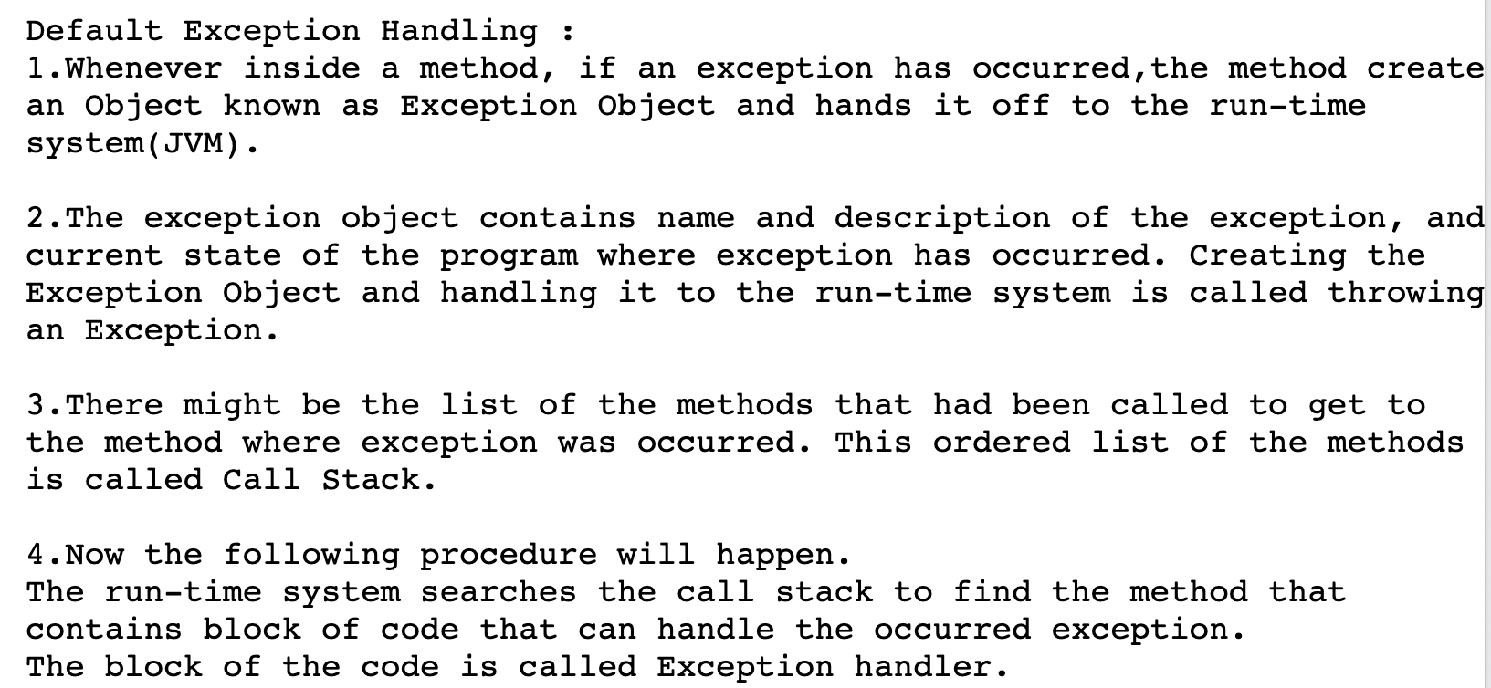
JAVA: How JVM handles Exception Handling?

Slide 18
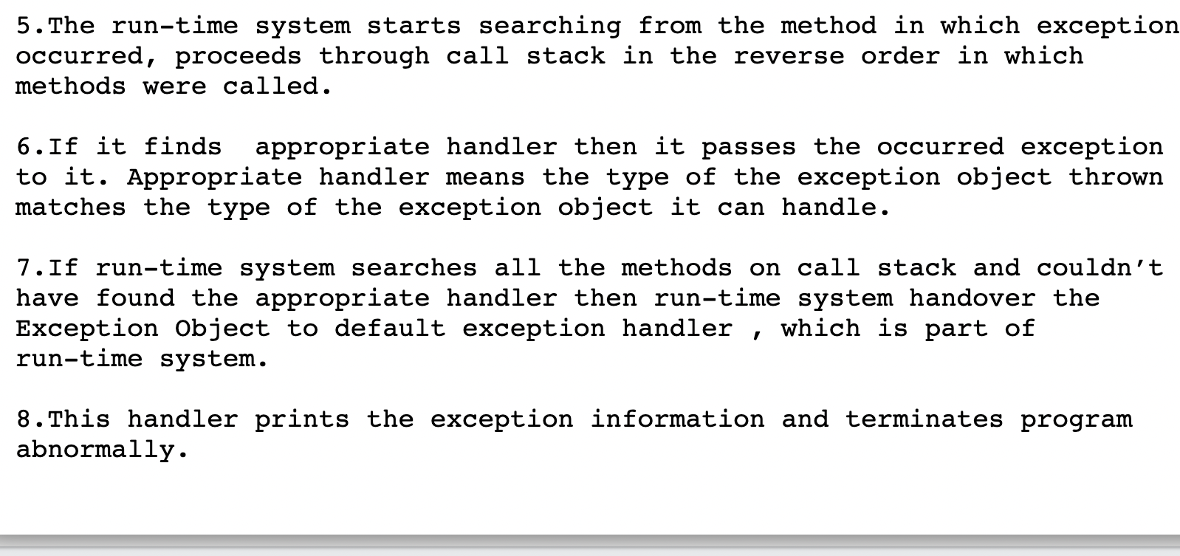
JAVA: How JVM handles Exception Handling?

Slide 19
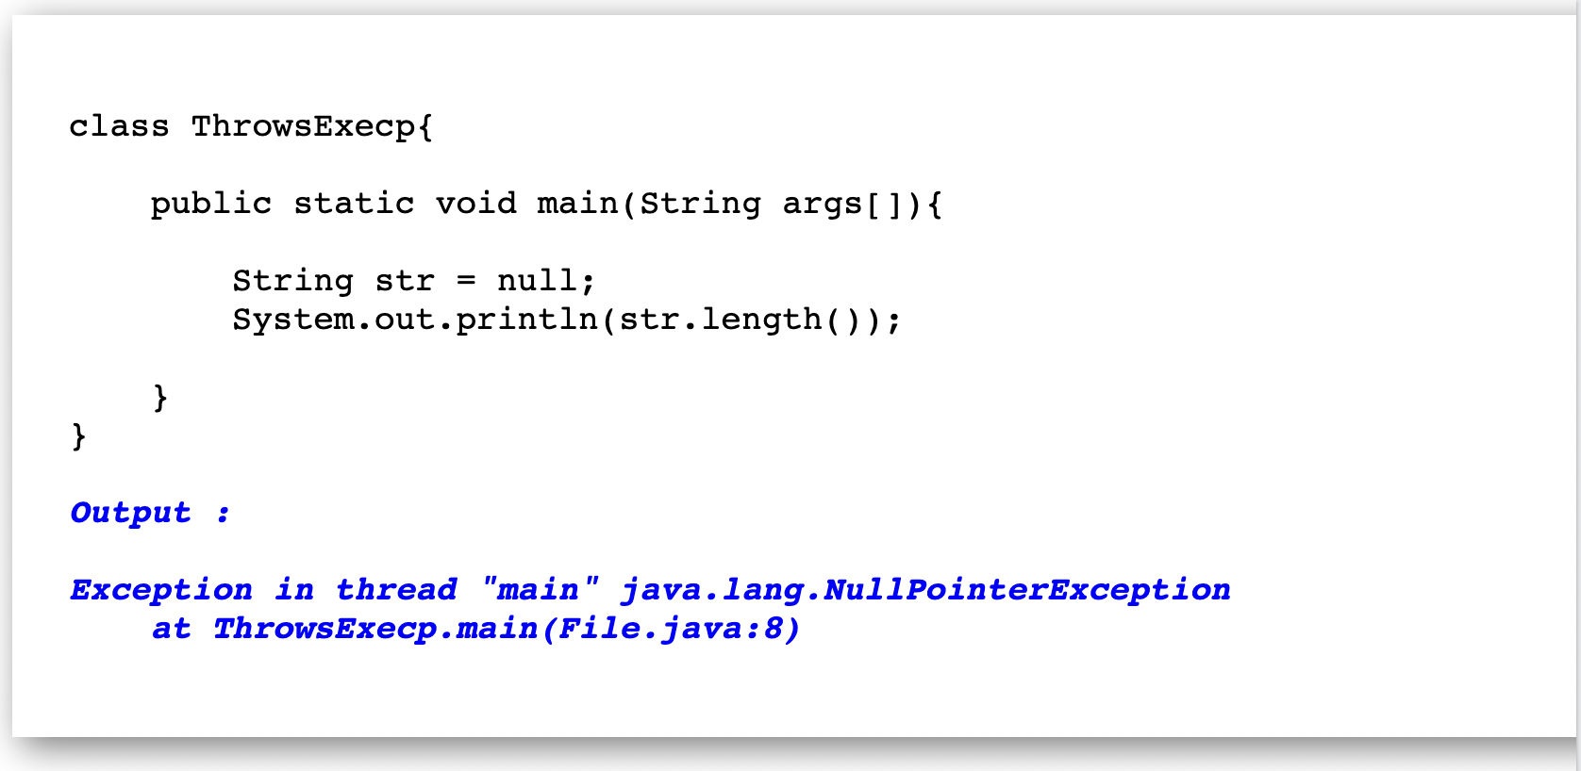
JAVA: How JVM handles Exception Handling?

Slide 20
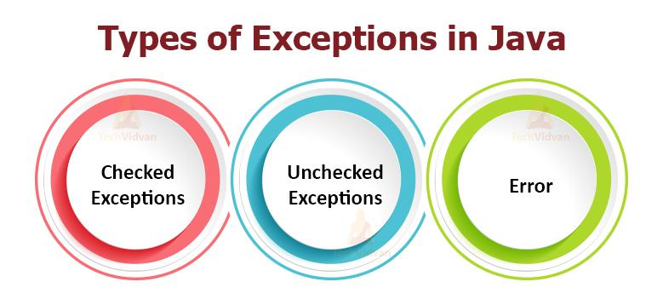
JAVA: Types Of Exception.

Slide 21
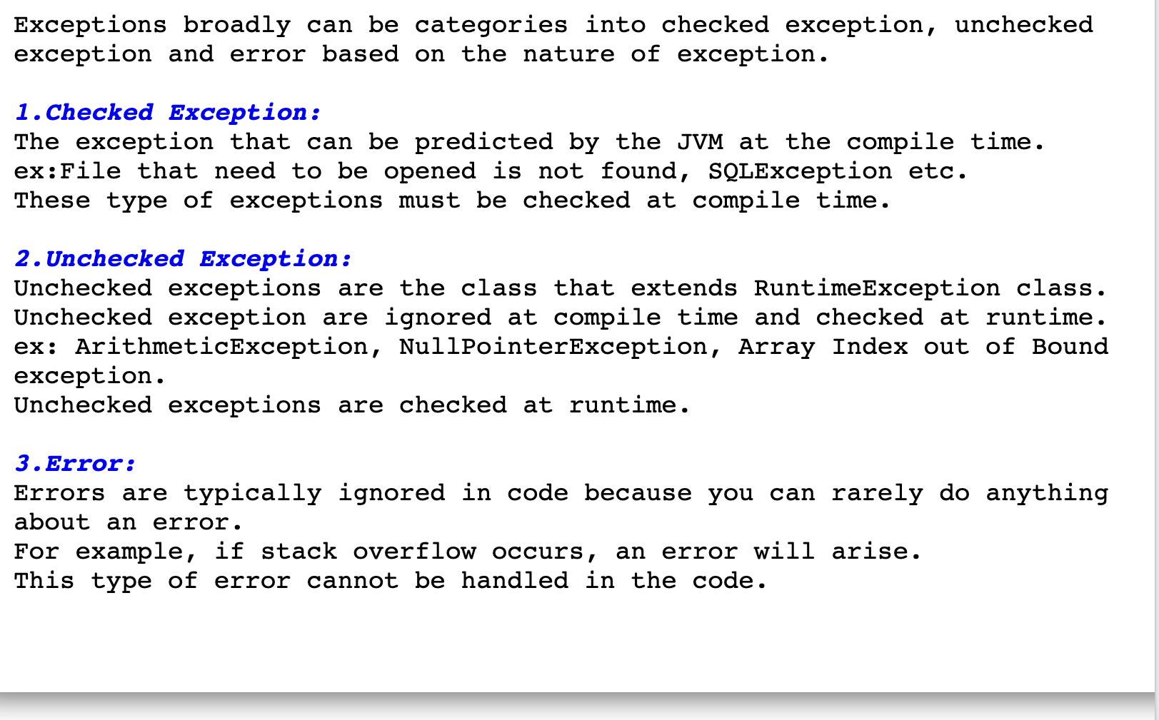
JAVA: Types Of Exception.

Slide 22
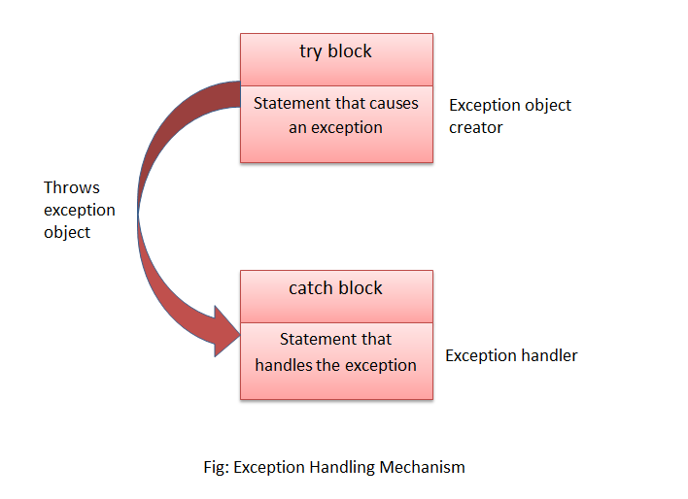
JAVA: Try-Catch Block.

Slide 23
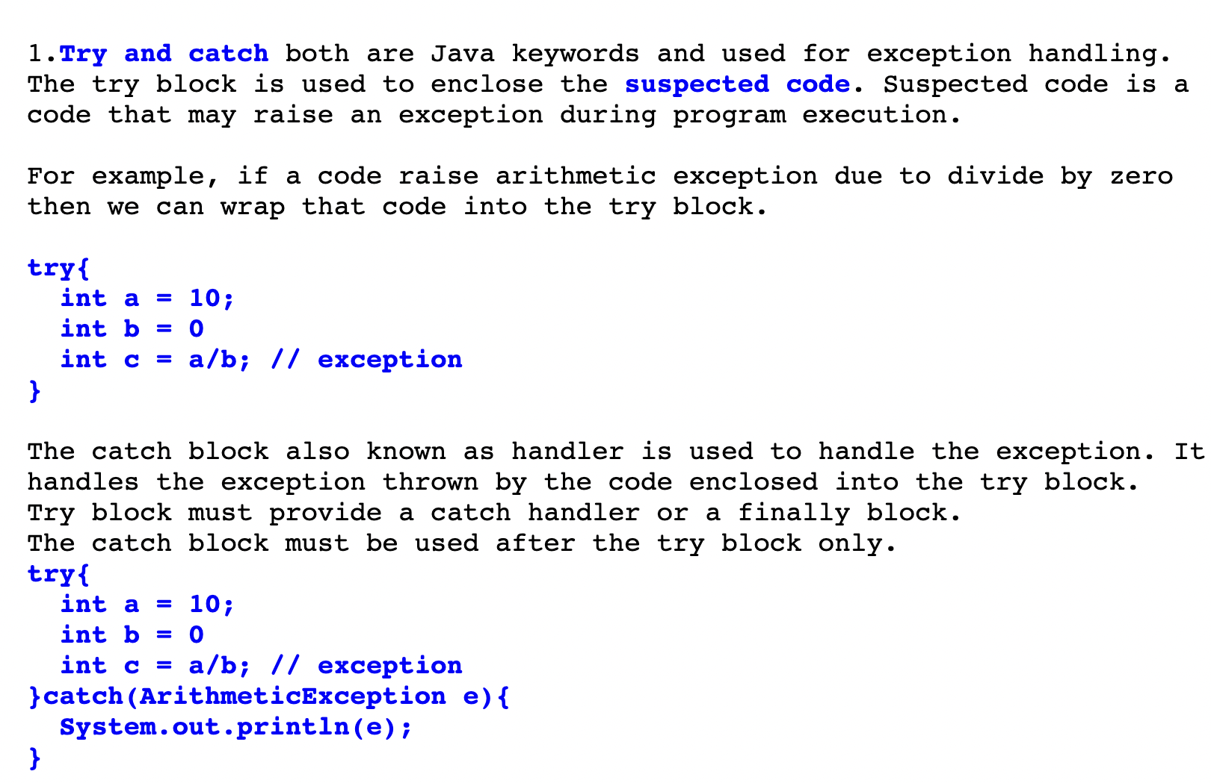
JAVA: Try-Catch Block.

Slide 24
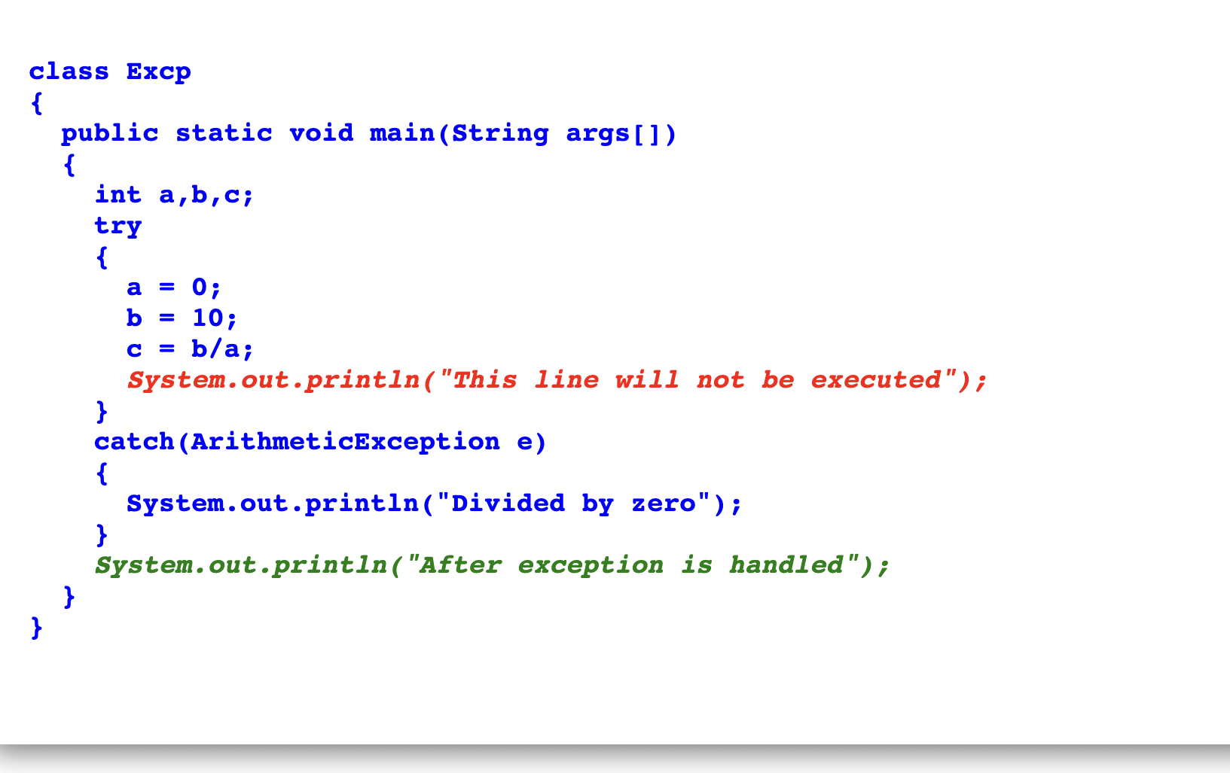
JAVA: Example On Try-Catch Block.

Slide 25
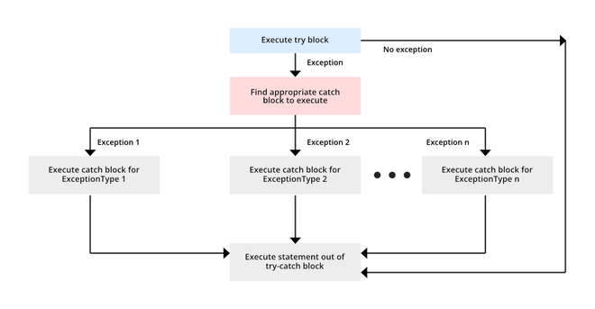
JAVA: Try With Multiple Catch Block.

Slide 26
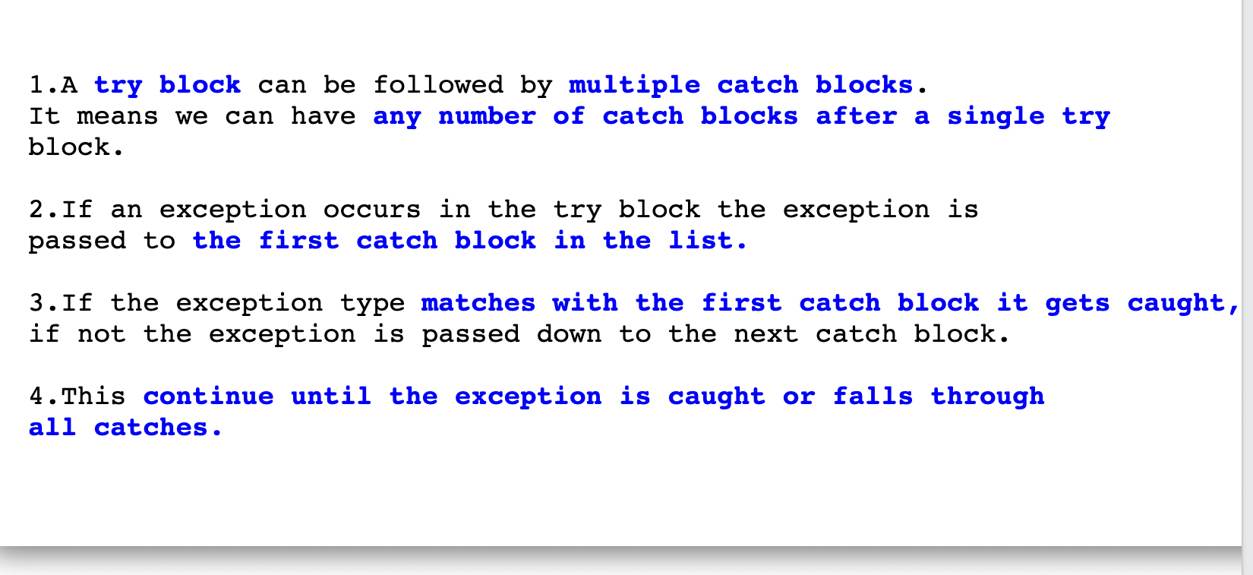
JAVA: Try With Multiple Catch Block.

Slide 27
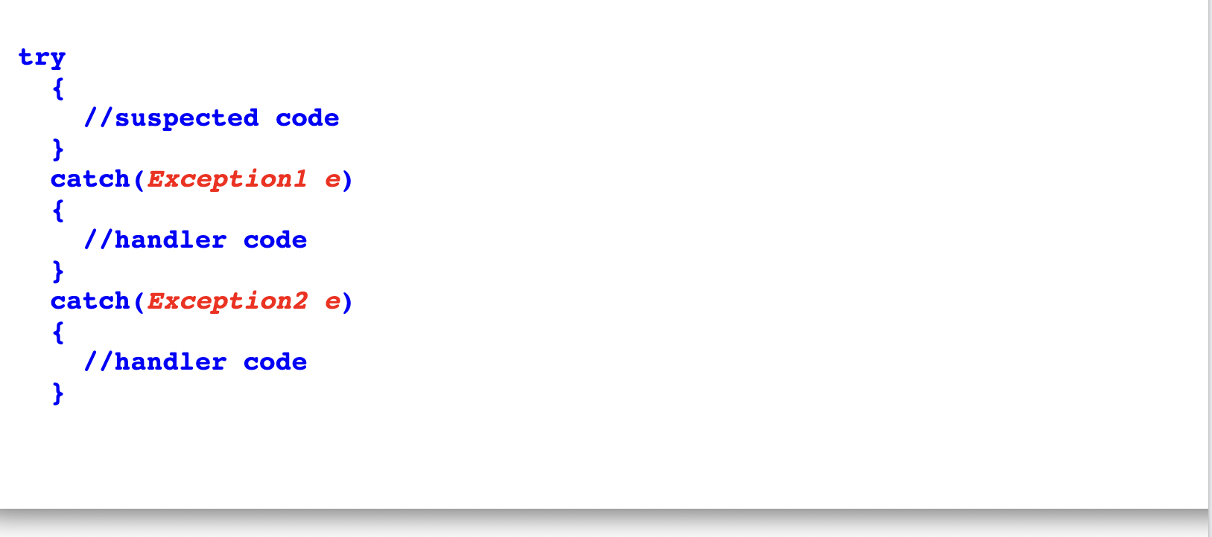
JAVA: Try With Multiple Catch Block Syntax.

Slide 28
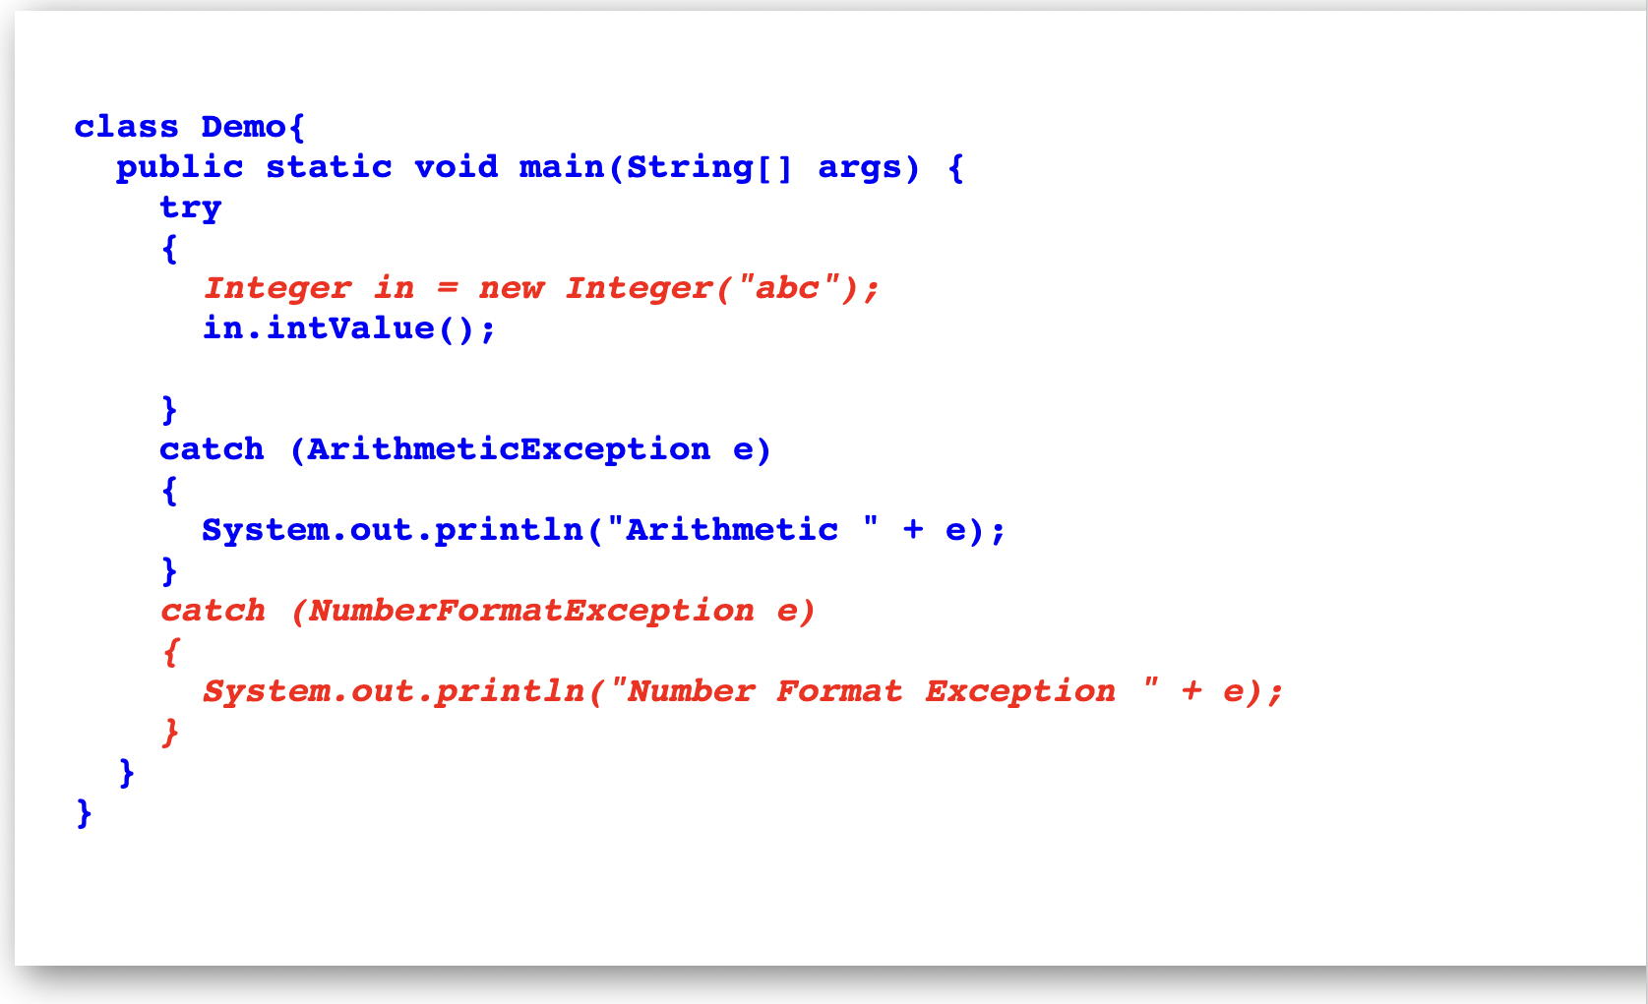
JAVA: Example On Try With Multiple Catch Block.

Slide 29
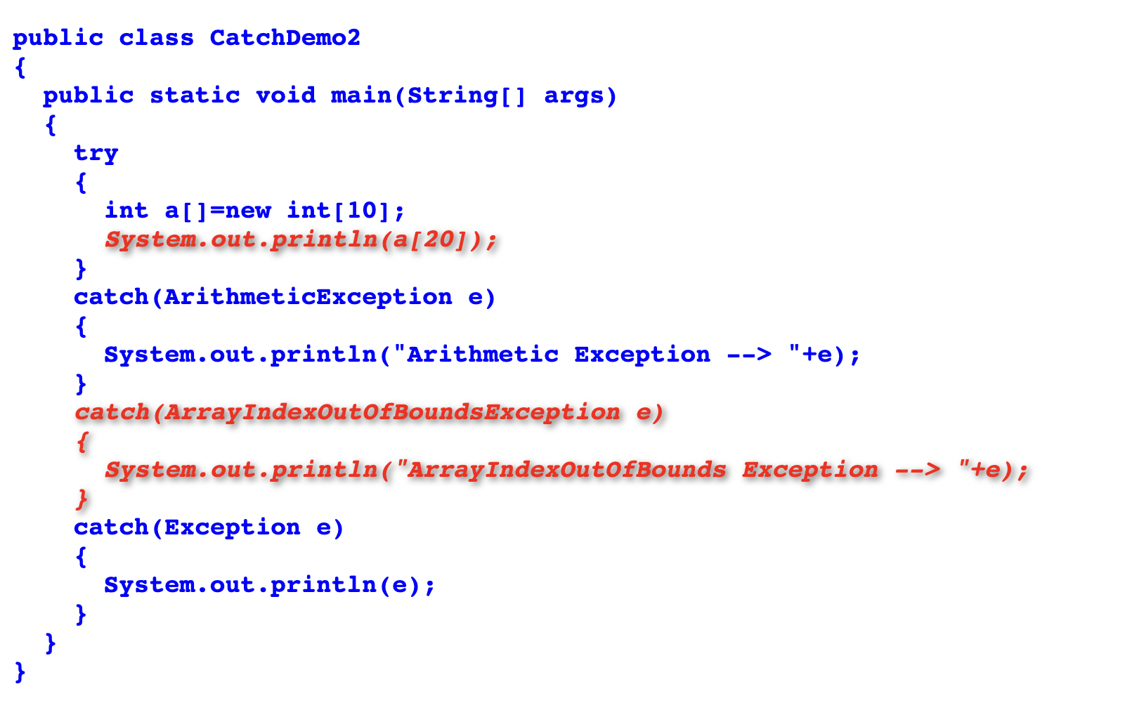
JAVA: Example On Try With Multiple Catch Block.

Slide 30
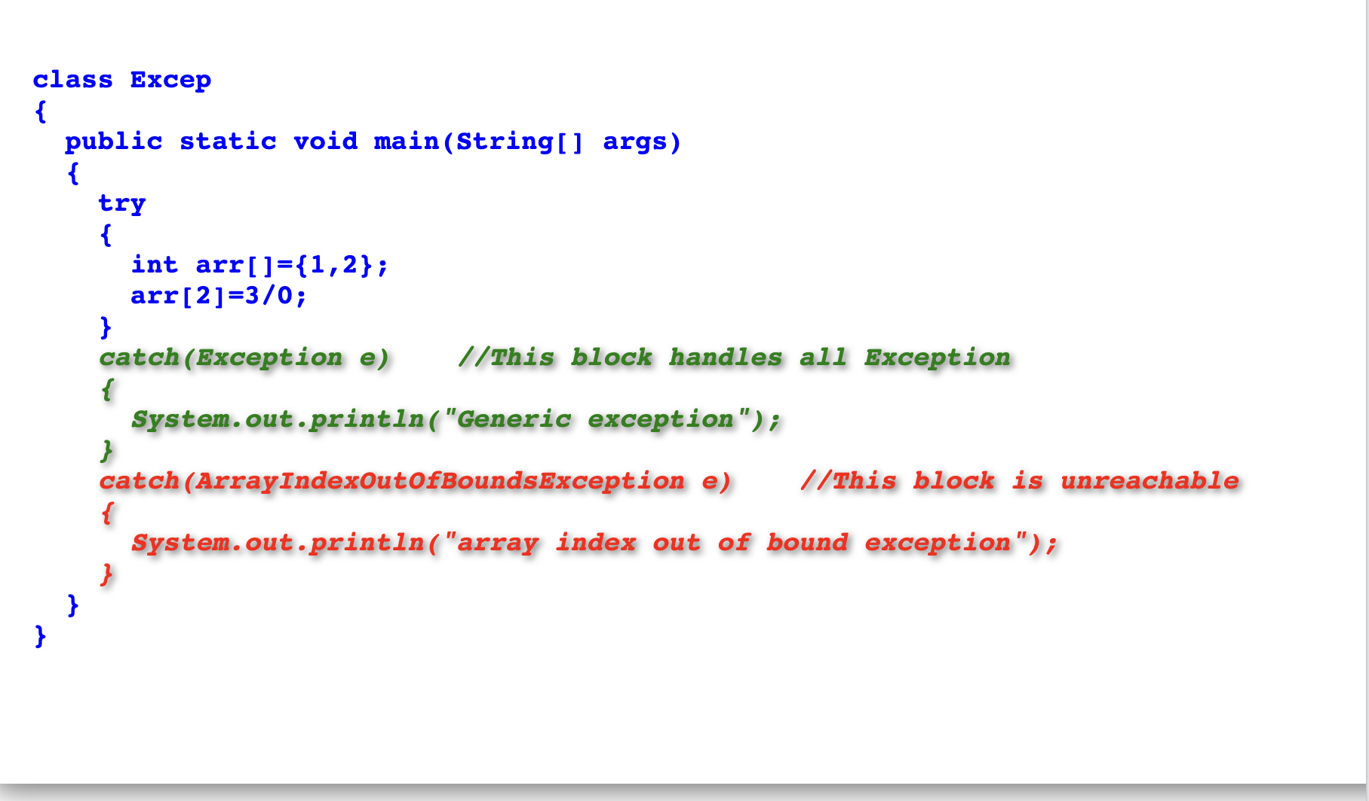
JAVA: Unreachable Catch Block Example.

Slide 31
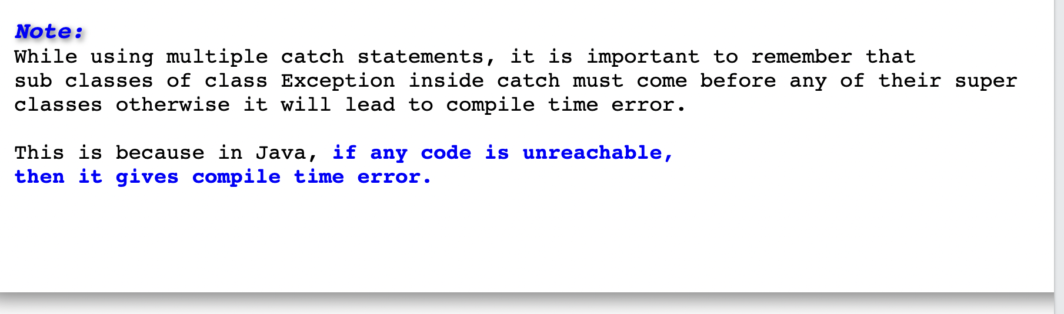
JAVA: Unreachable Catch Block Example.

Slide 32
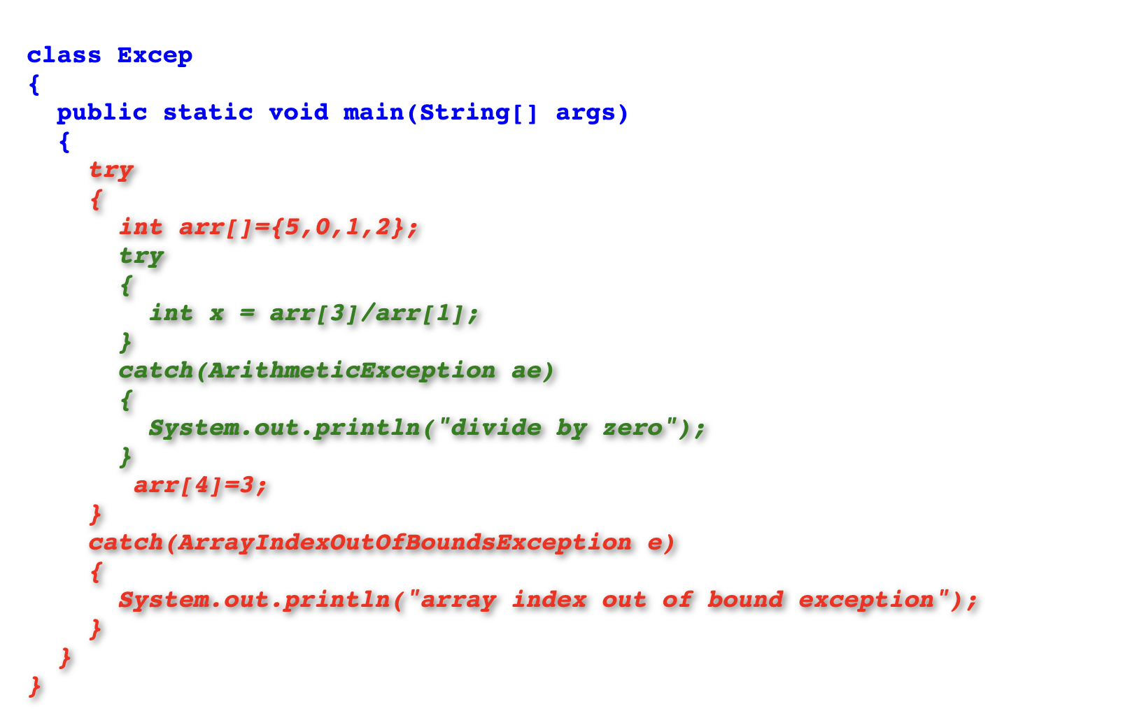
JAVA: Nested Try block Example.

Slide 33
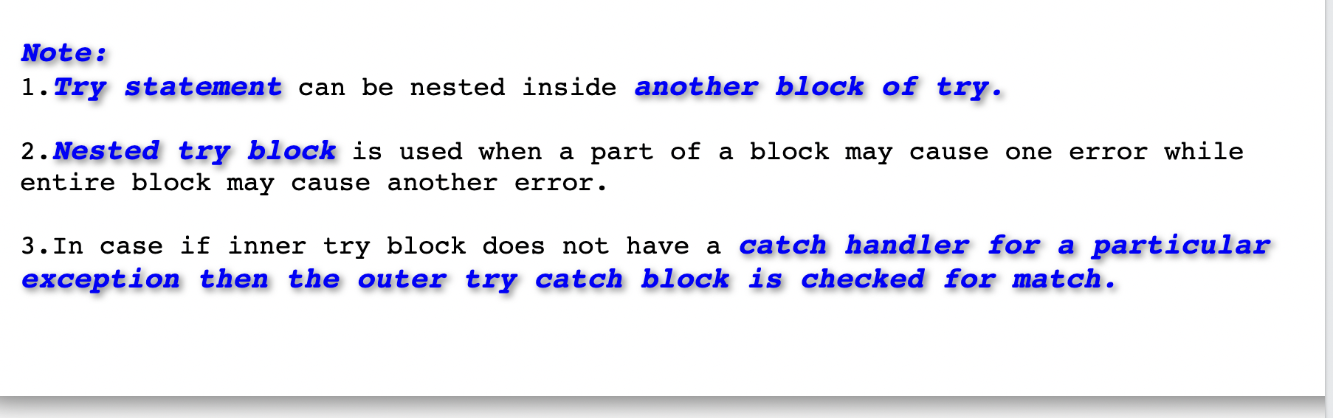
JAVA: Nested Try block.

Slide 34
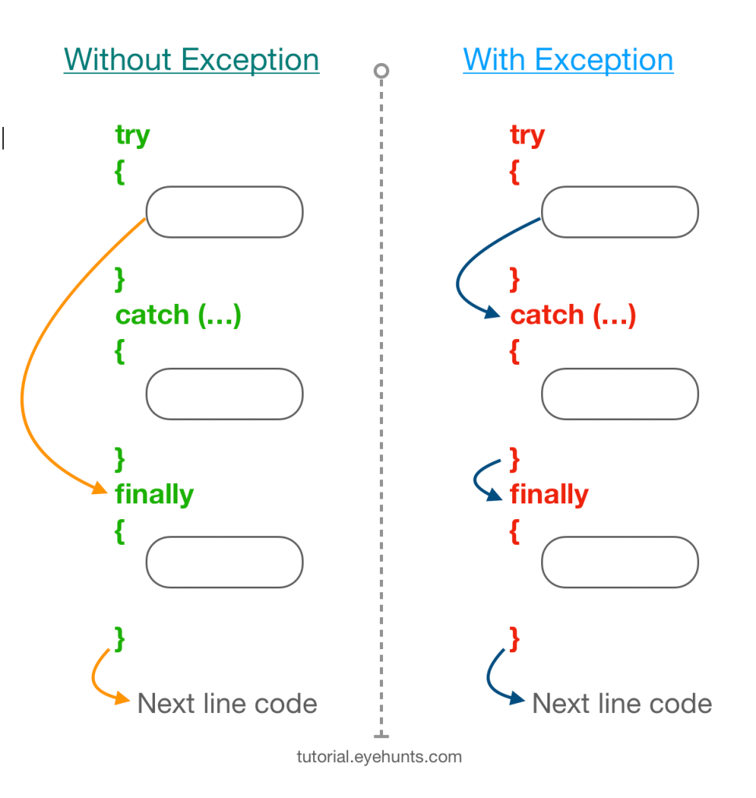
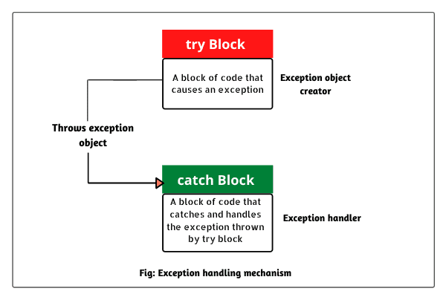
JAVA: Try-Catch-Finally.

Slide 35
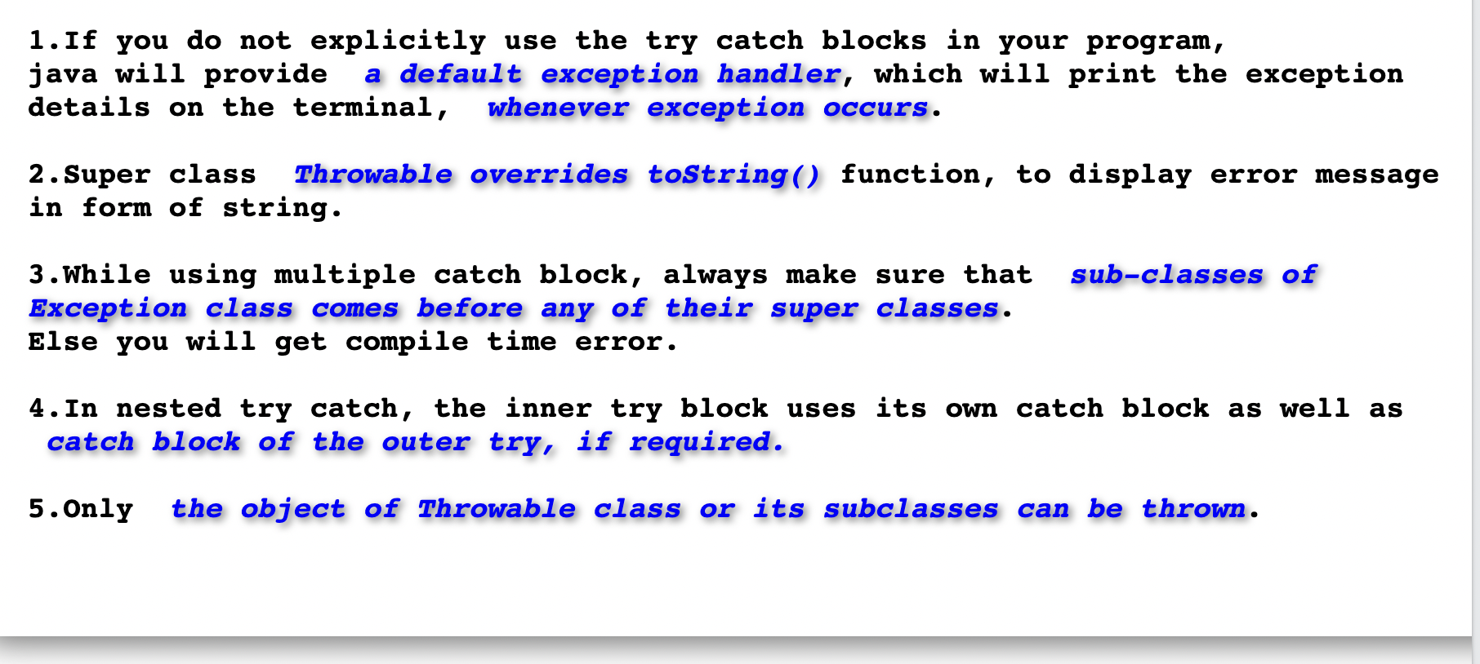
JAVA: Some Important Notes.

Slide 36
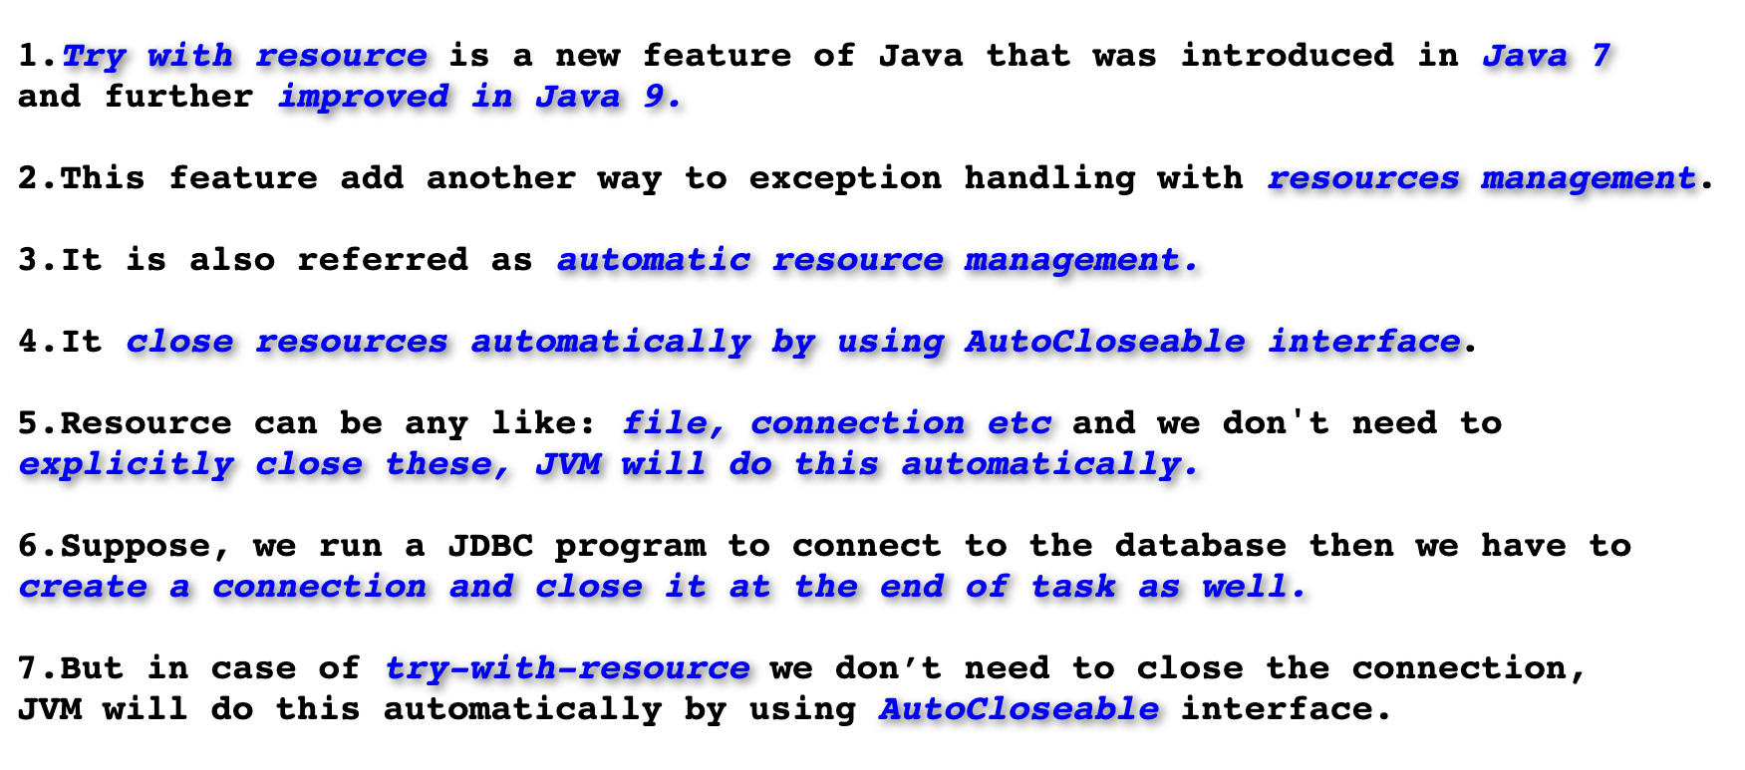
JAVA: Try-With-Resource.

Slide 37
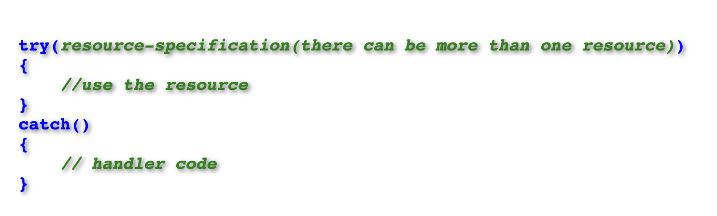
JAVA: Try-With-Resource Syntax.

Slide 38
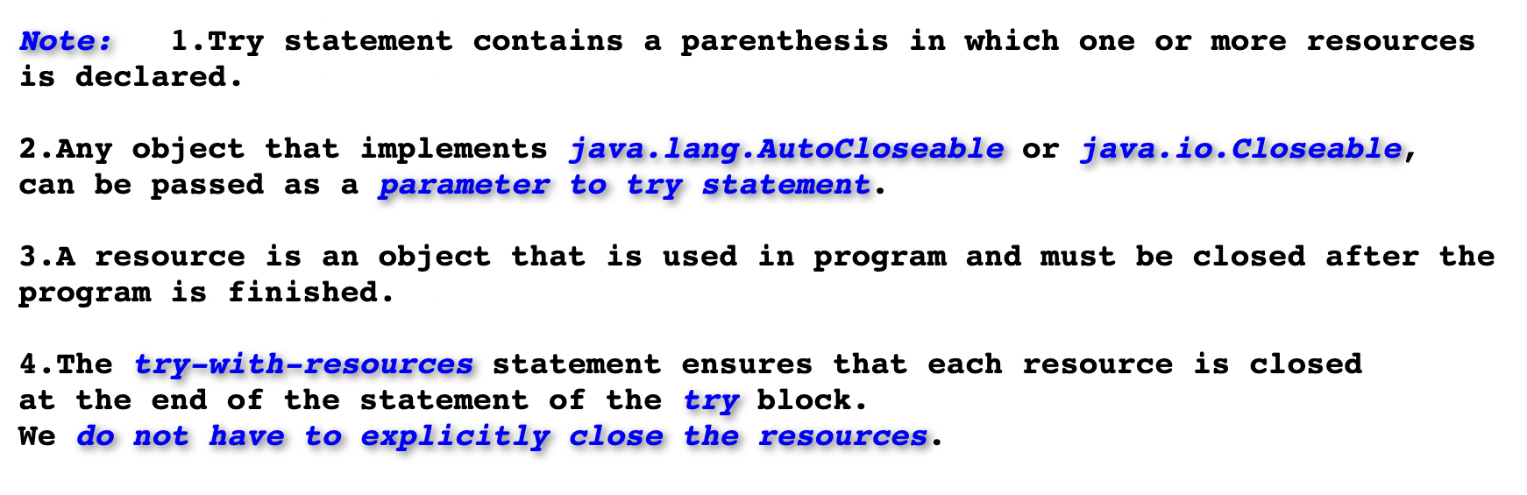
JAVA: Try-With-Resource Syntax.

Slide 39
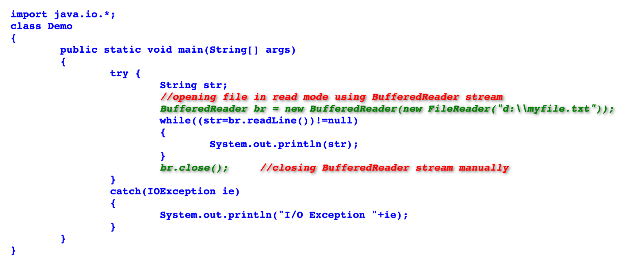
JAVA: Example Without Try-With-Resource.

Slide 40
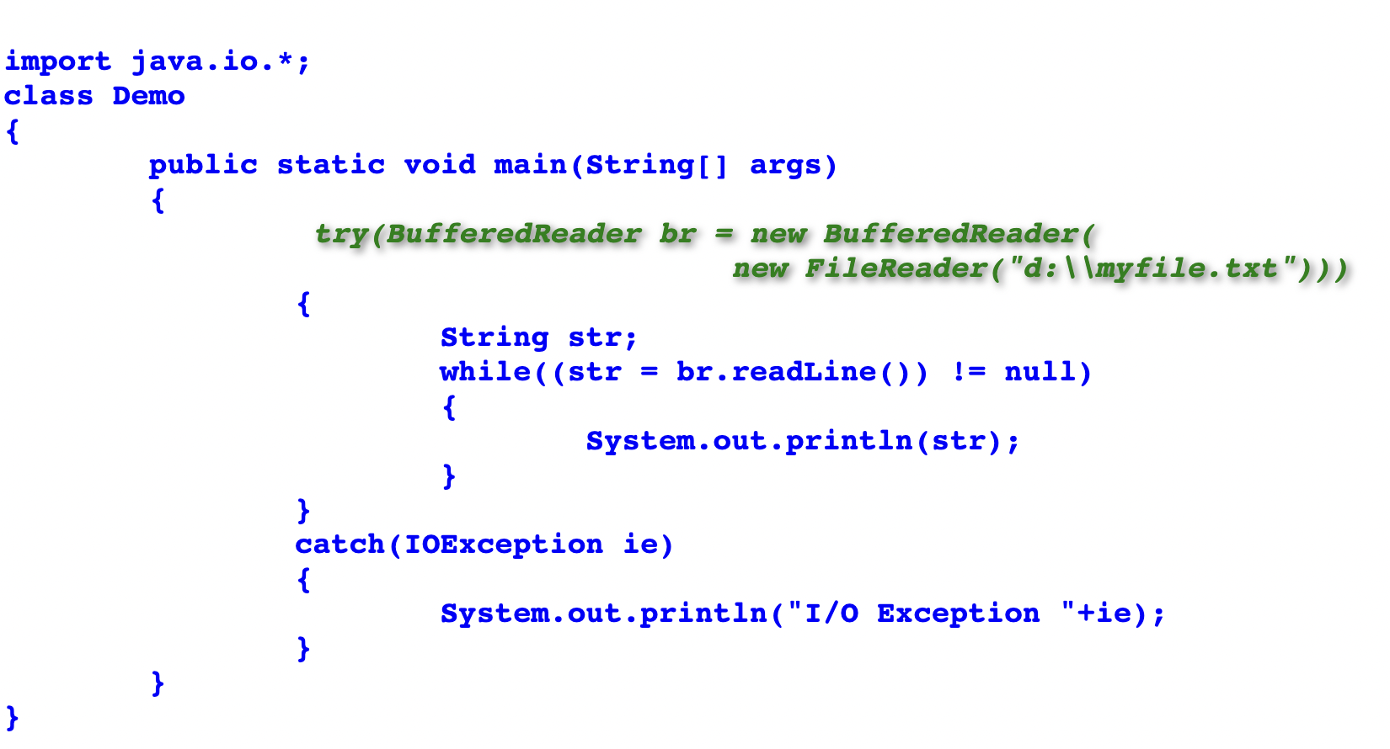
JAVA: Example Using Try-With-Resource.

Slide 41
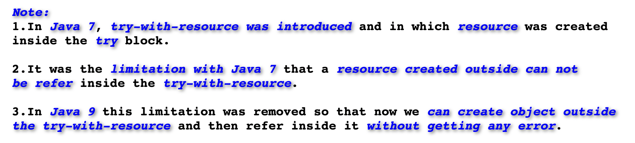
JAVA: Try-With-Resource Java-9.

Slide 42
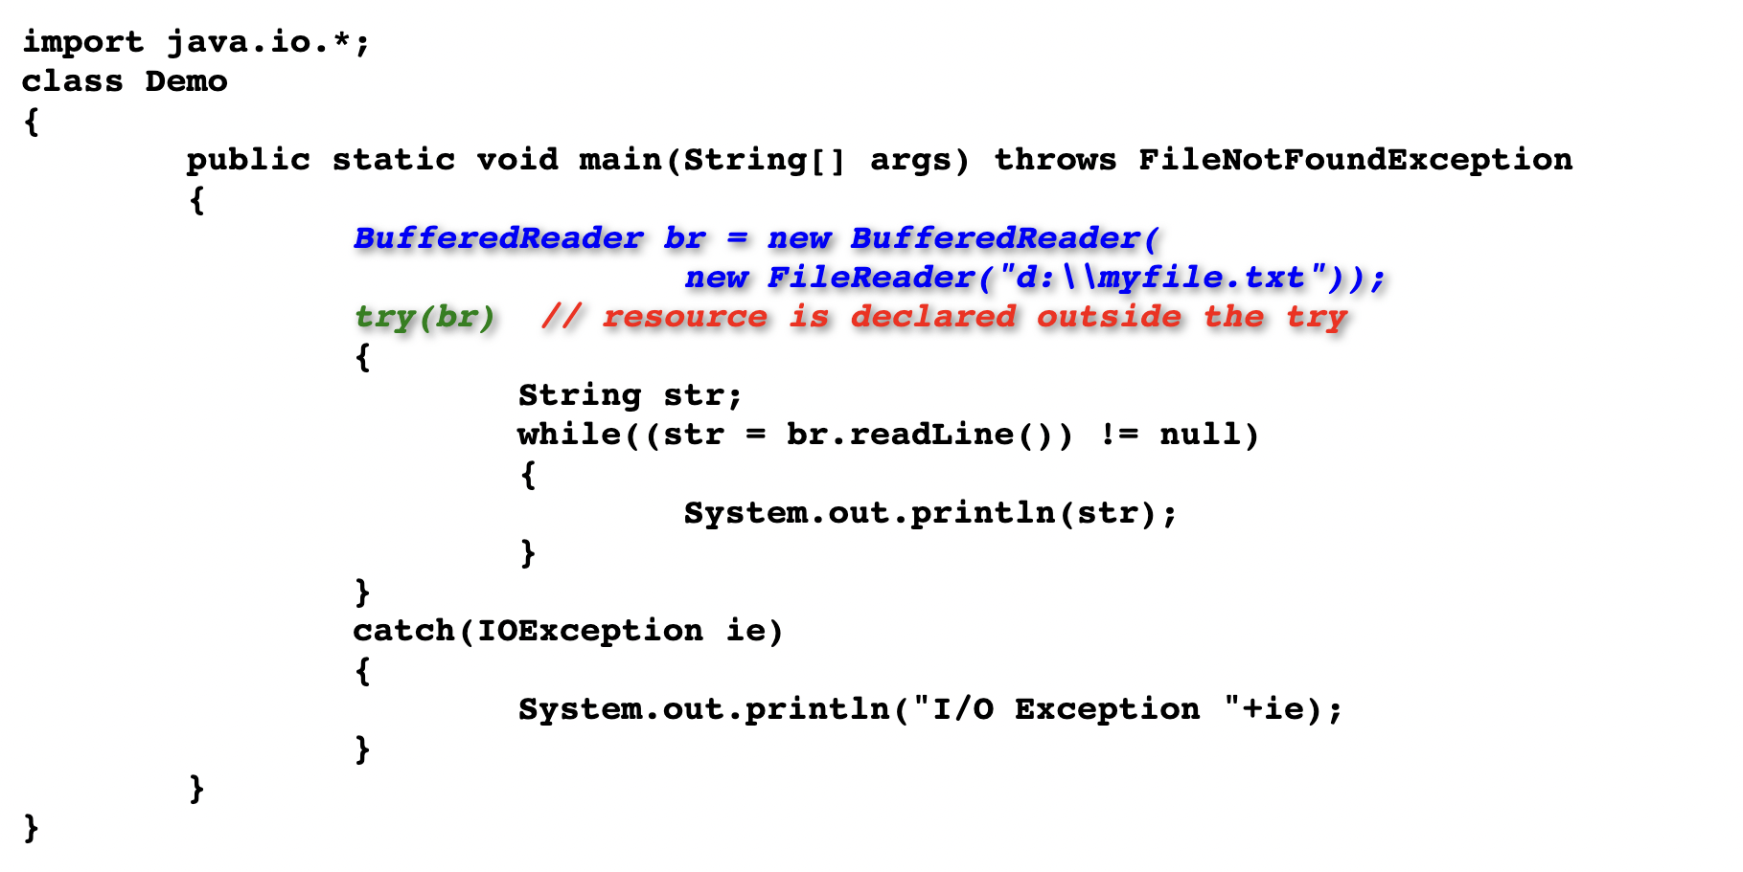
JAVA: Try-With-Resource Java-9.

Slide 43
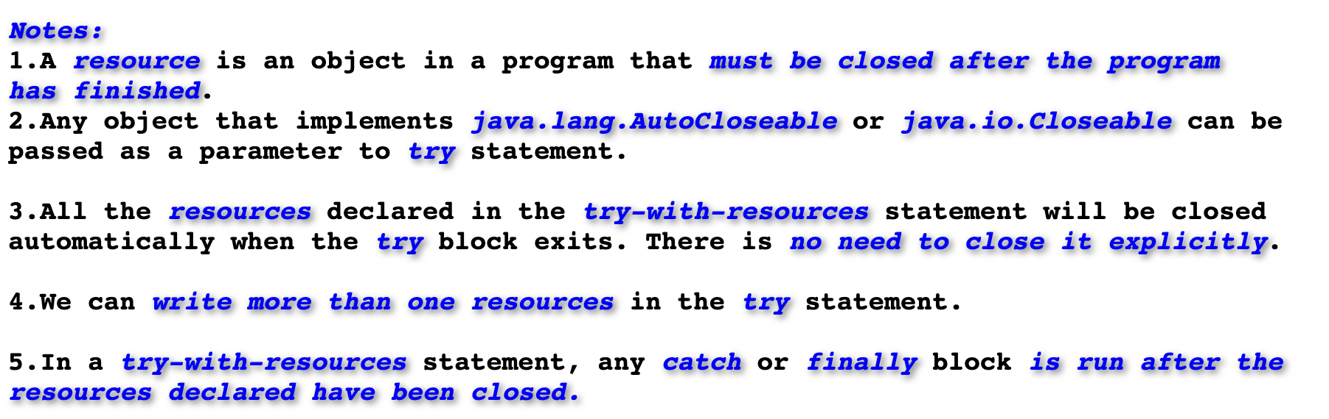
JAVA: Points To Remember Try-With-Resource.

Slide 44
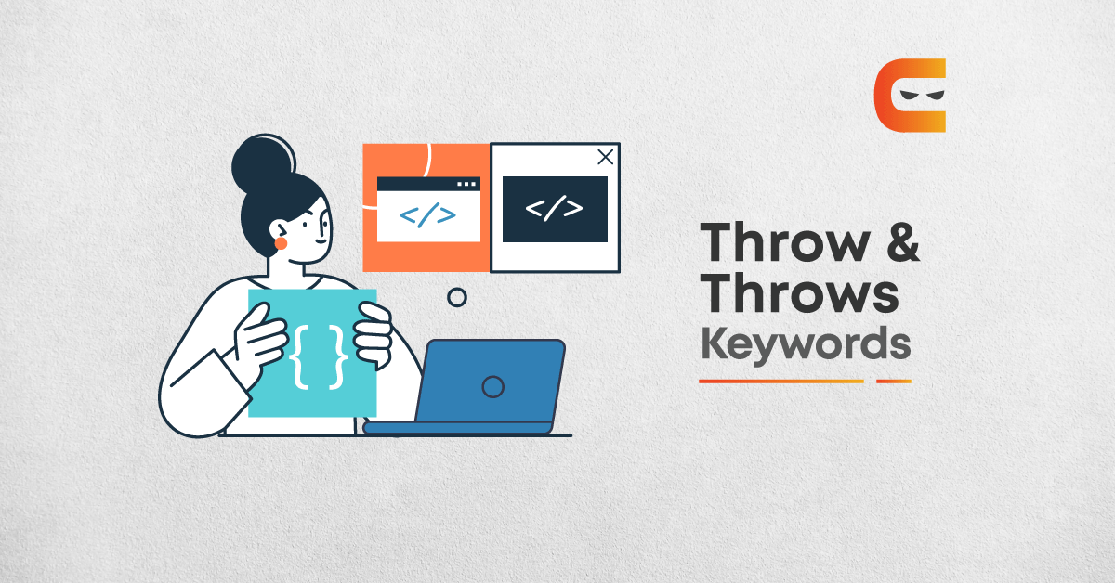
JAVA: Throw and Throws.

Slide 45
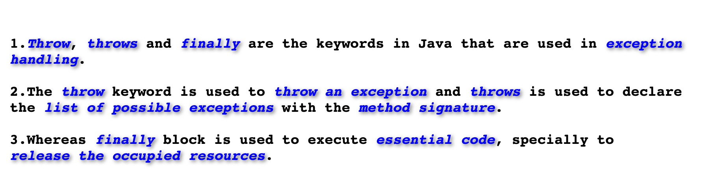
JAVA: Throw and Throws and Finally.

Slide 46
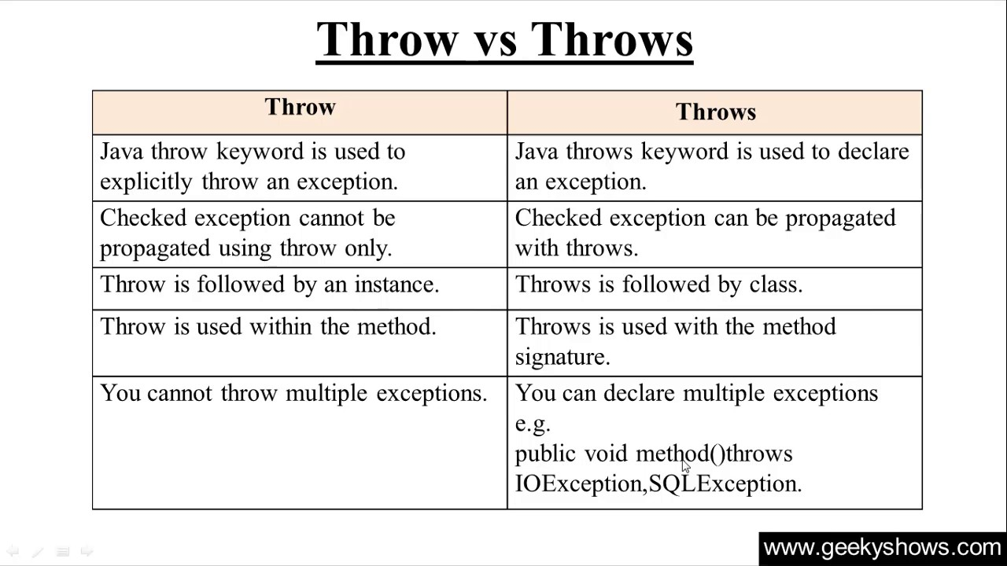
JAVA: Throw vs Throws.

Slide 47
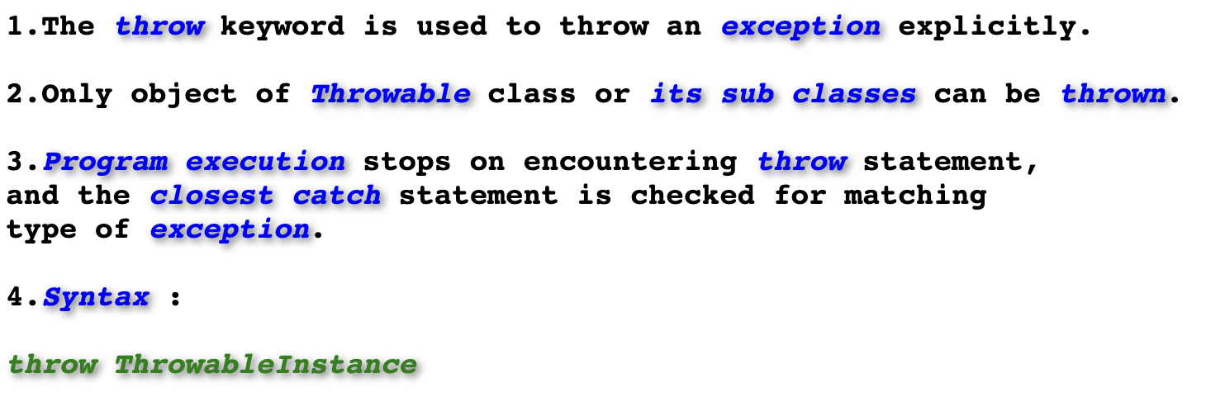
JAVA: Throw Keyword In Java

Slide 48
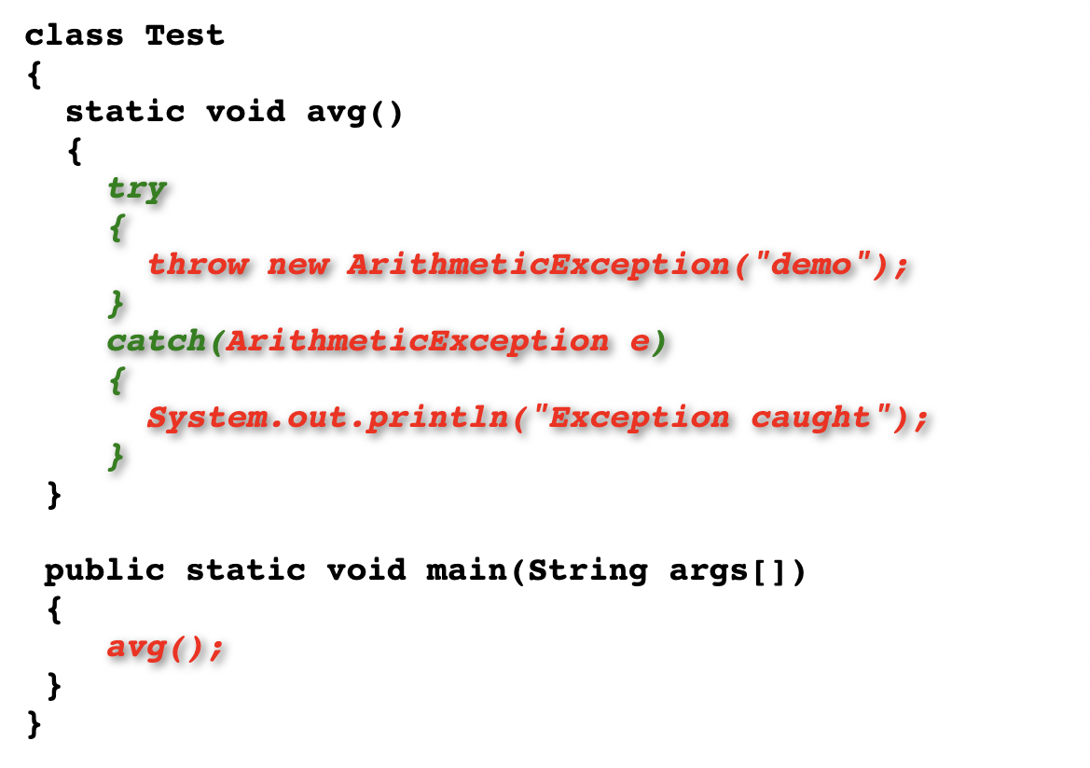
JAVA: Example On Throw Keyword .

Slide 49
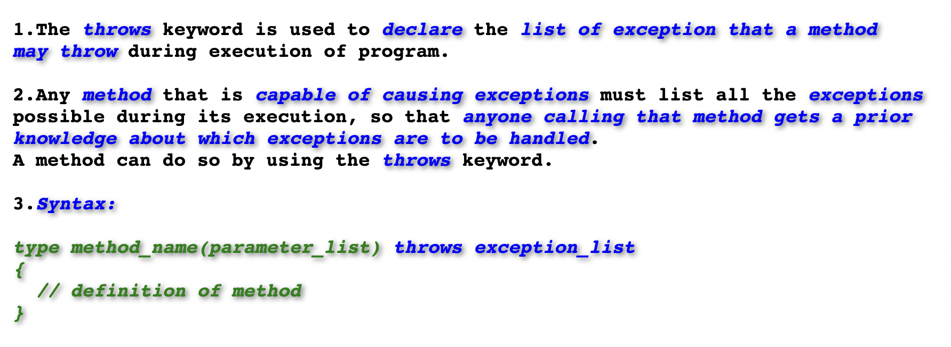
JAVA: Throws Keyword .

Slide 50
JAVA: Example On Throws Keyword .

Slide 51

JAVA: Example On Throws Keyword .

Slide 52

JAVA: Throw vs Throws

Slide 53

JAVA: Finally keyword

Slide 54

JAVA: Finally keyword

Slide 55

JAVA: Finally Example

Slide 56

JAVA: User Defined Exception or Custom Exception

Slide 57

JAVA: Example On Custom Exception

Slide 58

JAVA: Java Method Overriding ExceptionHandling

Slide 59

JAVA: Java Method Overriding with ExceptionHandling

Slide 60

JAVA: Overridden Method Throws Unchecked Exception

Slide 61

JAVA: Overridden Method Throws Unchecked Exception

Slide 62

JAVA: Chained Exception Example

Slide 63

JAVA: Chained Exception Example

